Slide 1
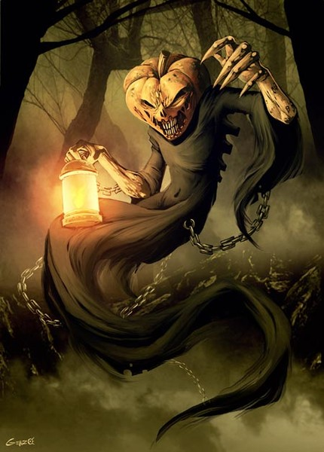
Myths & Legends of Halloween
The presentation was made by Fedorova Elena
school 129

Slide 2
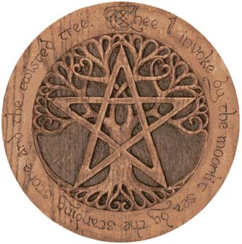
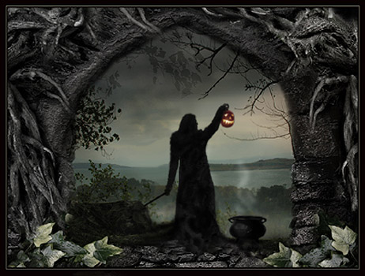
Halloween or the eve of all Saints Day is celebrated on the 31 of October. People remember their dead relatives. Halloween comes from the ancient Celtic Festival of Samhain which celebrates the coming of winter. It was believed that during this time the souls of dead visit their former homes to warm up by the fire. They collect donations such as food and fruit. They looks like vampires, devil, ghosts, werewolfs, witches.

Slide 3
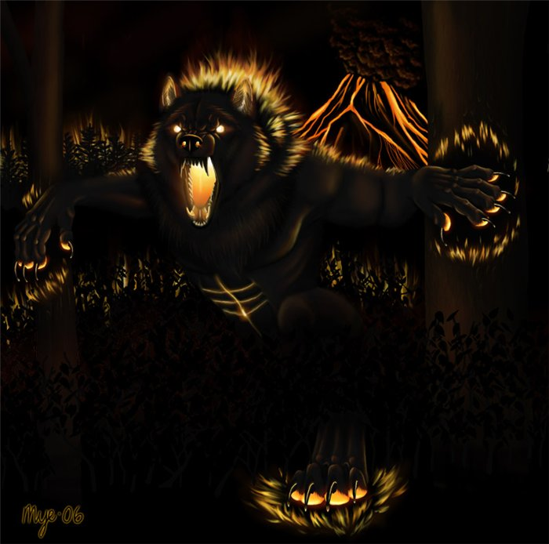
Werewolf
There is no more frightening than Wolf's howl at night, near your home. The Wolf was considered one of the worst enemies of man with incredible strength . It was cunning with an amazing appetite. They hunted mostly at night, attacked a village or a farm, it was very difficult to defend of them.

Slide 4
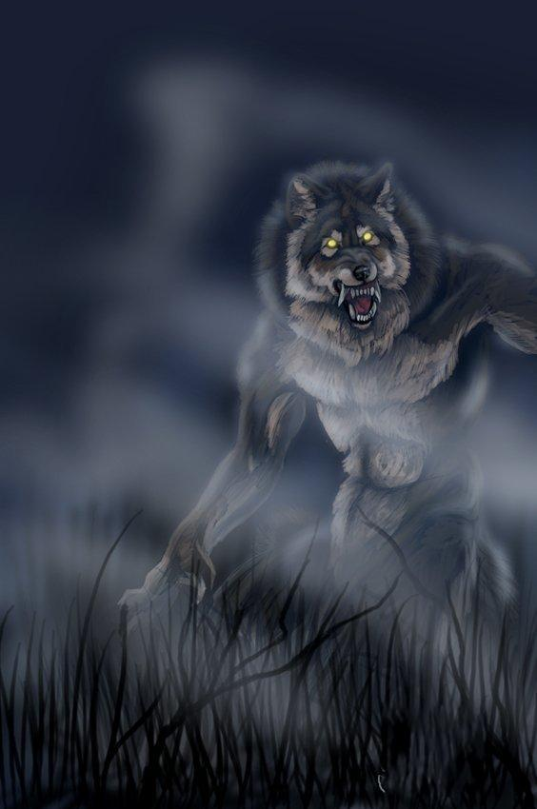
The notes of ancient Greek historians told about turning people into animals. The person changes very fast. The hands begin to swell and lengthen. Skin becomes rougher. Your fingers are bent themselves. Your tongue refuses to obey you. Howling, the man-beast disappeared and killed everyone who meets on the way.

Slide 5
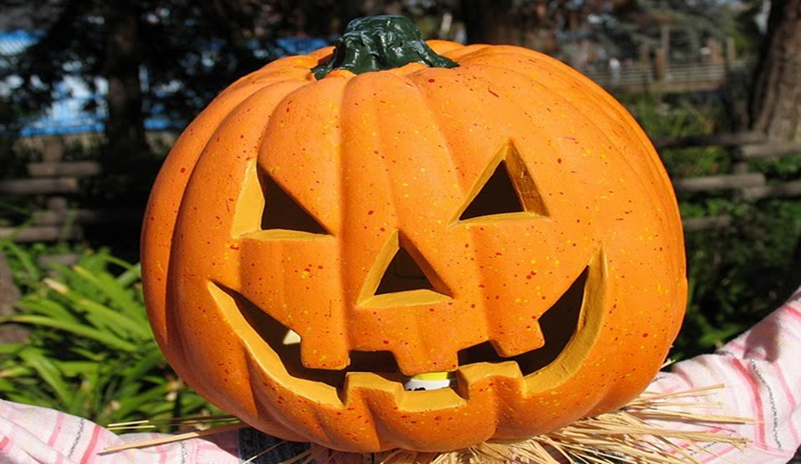
The main symbol of the holiday is called Jack-o-latern . It is a pumpkin, which cut ominously grinning face, inside the pumpkin is placed a lit candle. For the first time, "Jack lights" appeared in the UK, but originally used for the manufacture of a turnip or rutabaga. It was believed that this fruit left All Saints' Day around the house, will chase away evil spirits away. When the tradition of Halloween has spread to the United States, lamps were made ​​of gourds, more accessible and affordable.

Slide 6
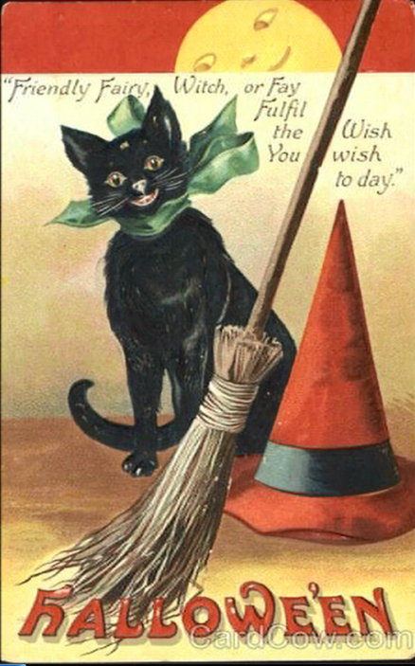
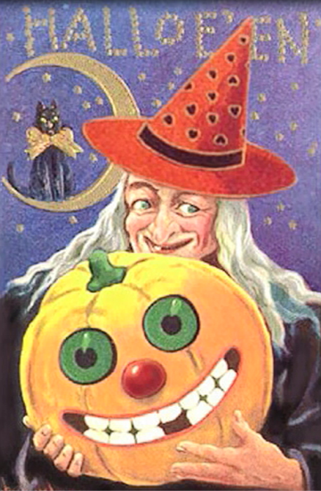
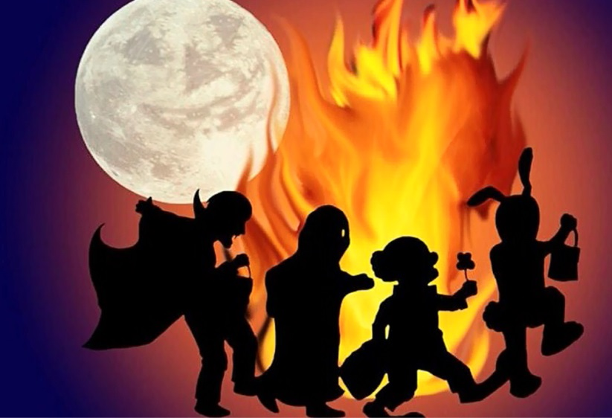
Halloween is one of the best holidays for children. American children celebrate Halloween on October 31. Children wear masks and colorful costumes. The most popular costumes are ghosts, witches, and skeletons. The children walk door to door in the neighborhood and shout “trick or treat!”. Most people give them a treat-candy or fruit. We also decorate our houses and schools in the traditional Halloween colors: orange and black. Popular decorations are witches, ghosts, skeletons, black cats, and jack-o-lanterns. Everyone tries to look scary on Halloween!

